Slide 1
Chapter 2
Basic Concepts
Line Configuration
Topology
Transmission Mode
Categories of Networks
Internetworks
WCB/McGraw-Hill
© The McGraw-Hill Companies, Inc., 1998

Slide 2
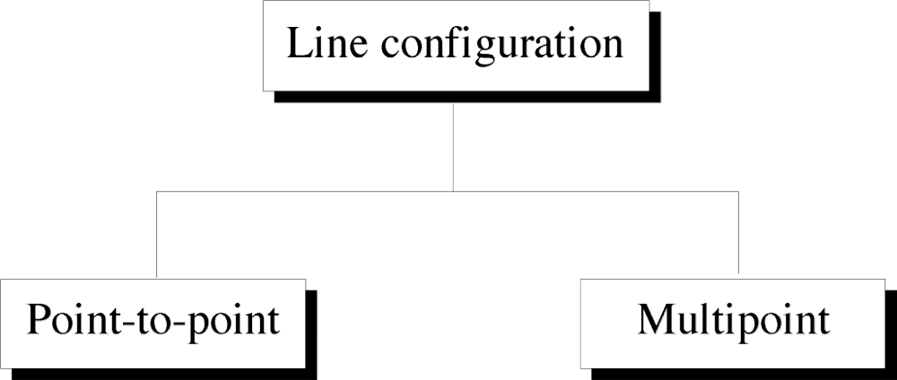
Figure 2-1
WCB/McGraw-Hill
© The McGraw-Hill Companies, Inc., 1998

Slide 3
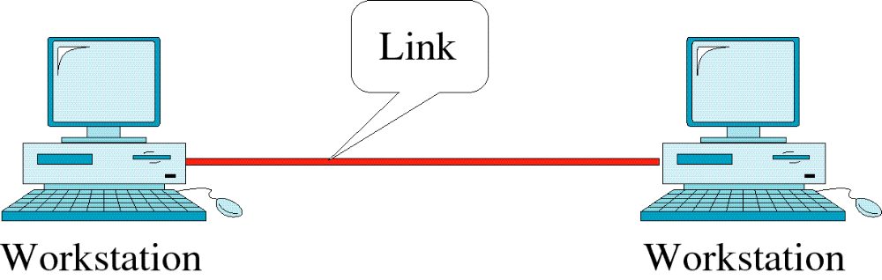
Figure 2-2
Point-to-Point Line Configuration
WCB/McGraw-Hill
© The McGraw-Hill Companies, Inc., 1998

Slide 4
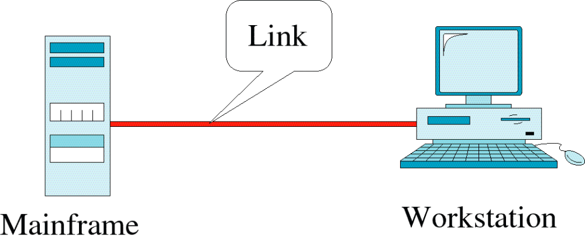
Figure 2-2-continued
Point-to-Point Line Configuration
WCB/McGraw-Hill
© The McGraw-Hill Companies, Inc., 1998

Slide 5
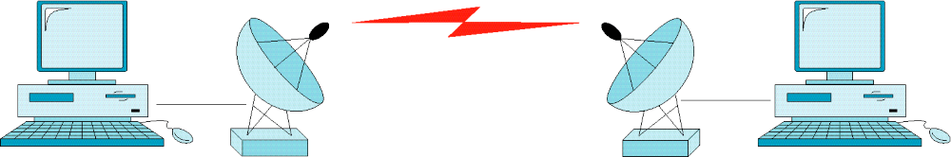
Figure 2-2-continued
Point-to-Point Line Configuration
WCB/McGraw-Hill
© The McGraw-Hill Companies, Inc., 1998

Slide 6
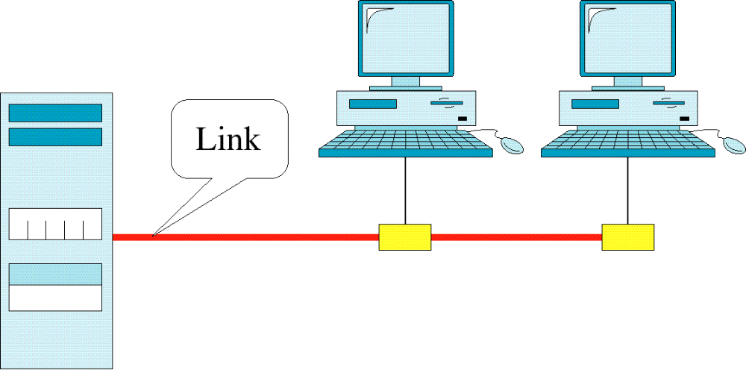
Figure 2-3
Multipoint Line Configuration
WCB/McGraw-Hill
© The McGraw-Hill Companies, Inc., 1998

Slide 7
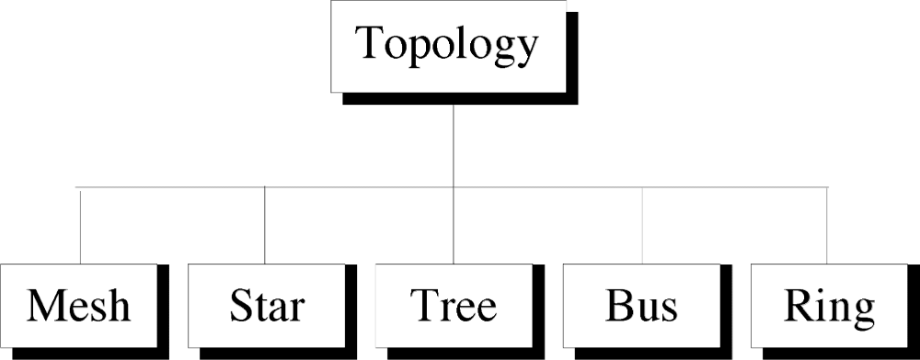
Figure 2-4
WCB/McGraw-Hill
© The McGraw-Hill Companies, Inc., 1998

Slide 8
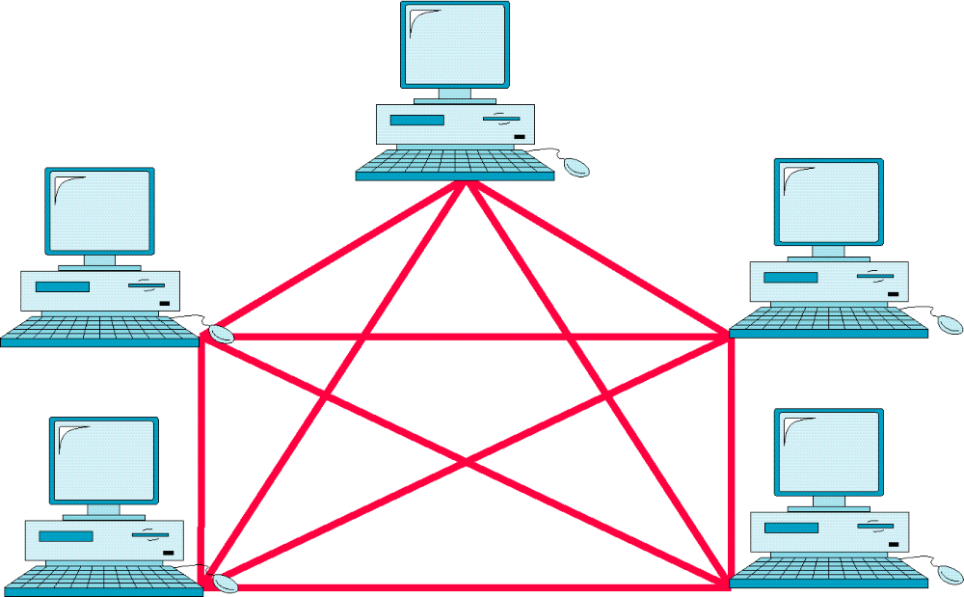
Figure 2-5
Mesh Topology
WCB/McGraw-Hill
© The McGraw-Hill Companies, Inc., 1998

Slide 9
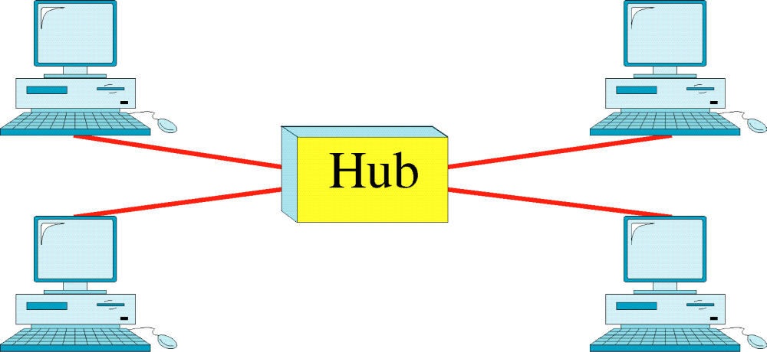
Figure 2-6
Star Topology
WCB/McGraw-Hill
© The McGraw-Hill Companies, Inc., 1998

Slide 10
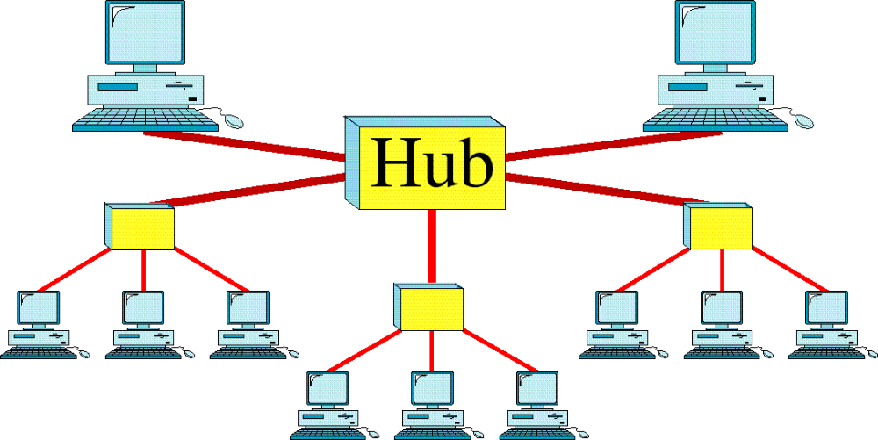
Figure 2-7
Tree Topology
WCB/McGraw-Hill
© The McGraw-Hill Companies, Inc., 1998

Slide 11
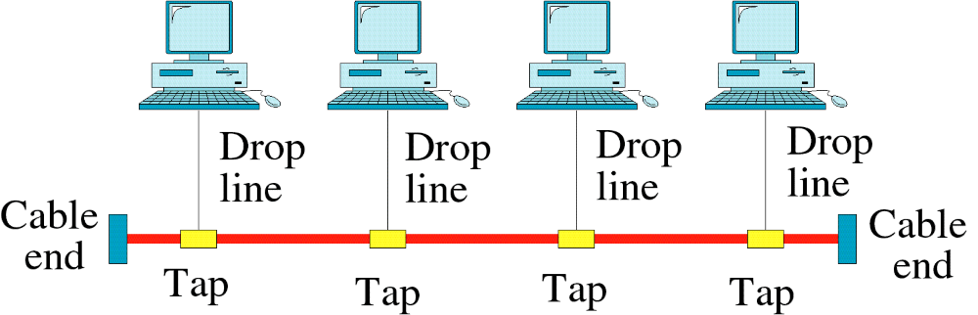
Figure 2-8
Bus Topology
WCB/McGraw-Hill
© The McGraw-Hill Companies, Inc., 1998

Slide 12
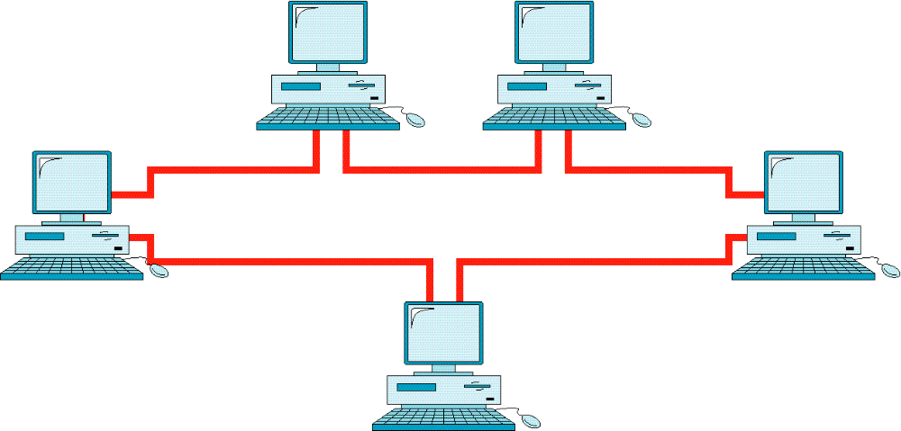
Figure 2-9
Ring Topology
WCB/McGraw-Hill
© The McGraw-Hill Companies, Inc., 1998

Slide 13
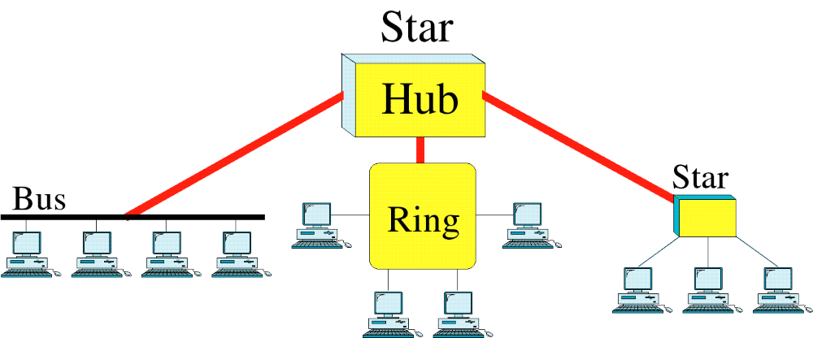
Figure 2-10
Hybrid Topology
WCB/McGraw-Hill
© The McGraw-Hill Companies, Inc., 1998

